Slide 1

Predicting Sleep Disorders: A Data-Driven Approach
Welcome to this presentation on predicting sleep disorders using a data-driven approach. In this project, we harness the power of machine learning to identify individuals at risk of developing sleep disorders, potentially revolutionizing early diagnosis and intervention strategies. Join us as we explore the methodology, findings, and future implications of this work. Let's dive in!

Slide 2
Introduction: Understanding Sleep Disorders and Project Goals
Project Goals
Understanding Sleep Disorders
This project aims to leverage machine learning techniques to predict sleep disorders based on various physiological and lifestyle factors. By analyzing a comprehensive dataset, we seek to identify key predictors and develop a robust model for early detection. The goal is to improve the accuracy and efficiency of sleep disorder diagnosis, enabling timely intervention and better patient outcomes.
Sleep disorders, such as insomnia, sleep apnea, and restless legs syndrome, affect millions worldwide. These conditions can significantly impact an individual's quality of life, leading to various health complications. Early diagnosis is crucial for effective management and treatment, highlighting the importance of predictive models in healthcare.
Aryan Pandya

Slide 3
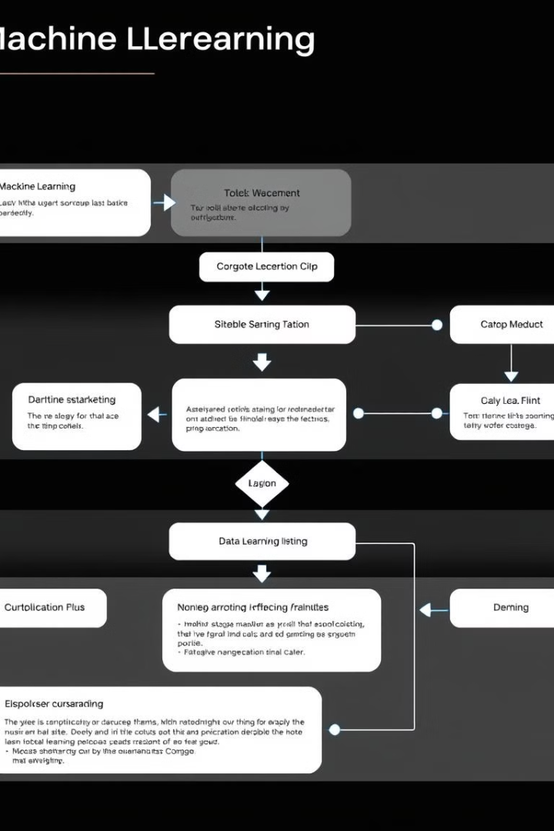




Model Building Workflow: A Visual Diagram
Data Collection
Gather relevant data. Ensure data quality and integrity.
Feature Engineering
Create and transform features. Prepare data for modeling.
Model Training
Train ML models. Optimize model parameters.
Evaluation
Evaluate model performance. Refine model as needed.
Aryan Pandya

Slide 4
The Challenge: Early Detection for Better Healthcare Outcomes
1
Key Challenges
2
Benefits of Early Detection
3
Healthcare Impact
One of the primary challenges in managing sleep disorders is the lack of early detection. Many individuals remain undiagnosed for years, leading to prolonged suffering and increased healthcare costs. Developing effective diagnostic tools and predictive models is crucial for addressing this issue.
The early detection of sleep disorders can have a significant impact on healthcare systems worldwide. By improving diagnostic accuracy and efficiency, healthcare providers can allocate resources more effectively and provide better care to those in need. Predictive models offer a promising solution for addressing the growing burden of sleep disorders.
Early detection of sleep disorders offers numerous benefits, including timely intervention, improved patient outcomes, and reduced healthcare costs. By identifying individuals at risk, healthcare providers can implement personalized treatment plans and prevent the development of more severe complications.
Aryan Pandya

Slide 5
Data Acquisition: Gathering Insights from Sleep Patterns
Dataset Details
Data Sources
Key Variables
The dataset used in this project consists of comprehensive information on sleep patterns, physiological factors, and lifestyle habits. It includes variables such as age, gender, BMI, blood pressure, heart rate, sleep duration, and physical activity levels. This rich dataset provides a solid foundation for building predictive models.
The data was collected from various sources, including sleep clinics, wearable devices, and self-reported surveys. This diverse range of sources ensures a representative sample and minimizes potential biases. The combination of clinical data and real-world measurements enhances the accuracy and reliability of the analysis.
Key variables in the dataset include sleep duration, sleep quality, physical activity levels, stress levels, and the presence of other health conditions. These variables have been identified as potential predictors of sleep disorders based on previous research and clinical expertise.
Aryan Pandya

Slide 6



Exploratory Data Analysis: Unveiling Key Sleep Insights
Visual Analysis
Correlation Matrices
Distribution Analysis
Exploratory Data Analysis (EDA) is a crucial step in understanding the underlying patterns and relationships within the data. Through visual analysis, we gain insights into the distribution of key variables and identify potential correlations between them. This information informs the feature engineering and model selection processes.
Correlation matrices are used to identify relationships between variables. By examining the strength and direction of these correlations, we can gain a deeper understanding of the factors that contribute to sleep disorders. Strong positive or negative correlations may indicate important predictors.
Distribution analysis involves examining the frequency and spread of values for each variable. Histograms, box plots, and other visual tools are used to identify patterns such as skewness, outliers, and modality. This information helps in cleaning and transforming the data for model building.
Aryan Pandya

Slide 7

Data Acquisition and Exploration
The initial dataset consists of a variety of sleep-related features. We will explore sleep duration, sleep quality, physical activity, stress levels, and BMI. Analyzing relationships between these variables, we aim to identify trends and correlations.
1
Features
2
Analysis
Sleep duration, quality, activity.
Identify trends and correlations.
Aryan Pandya

Slide 8
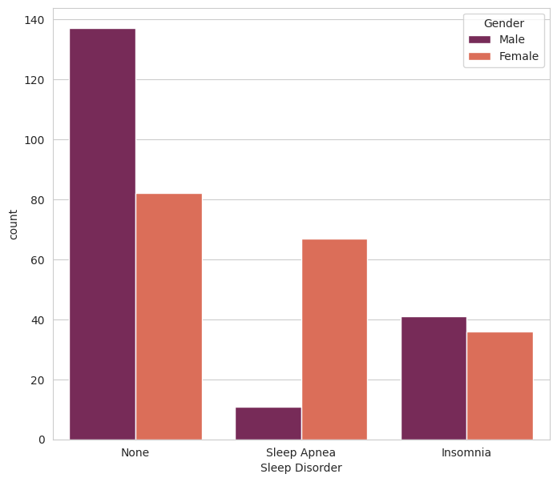
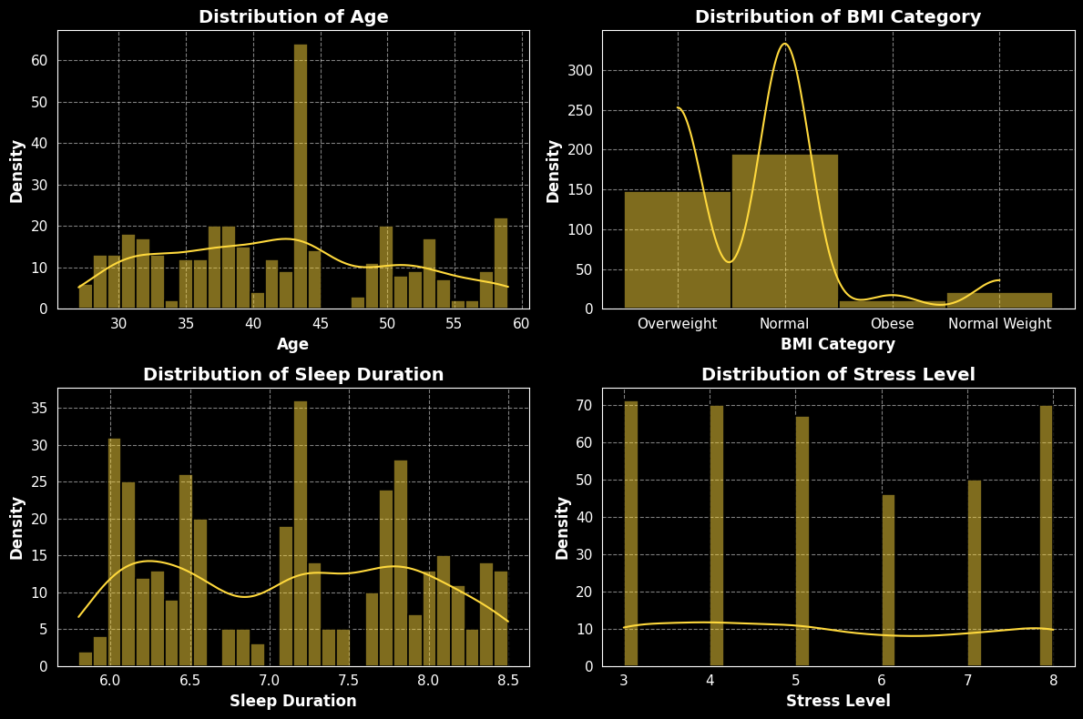
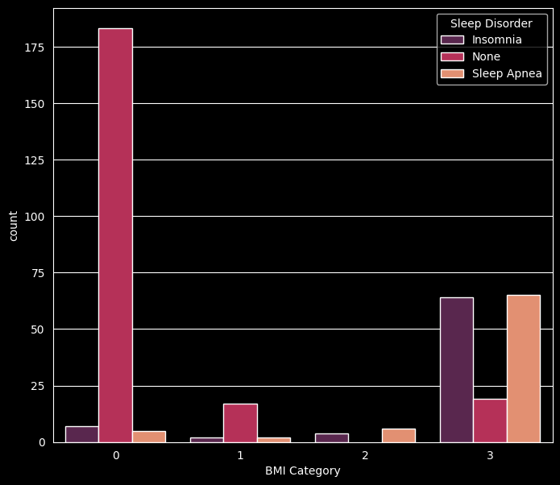
EDA:
Visual Analysis

Slide 9
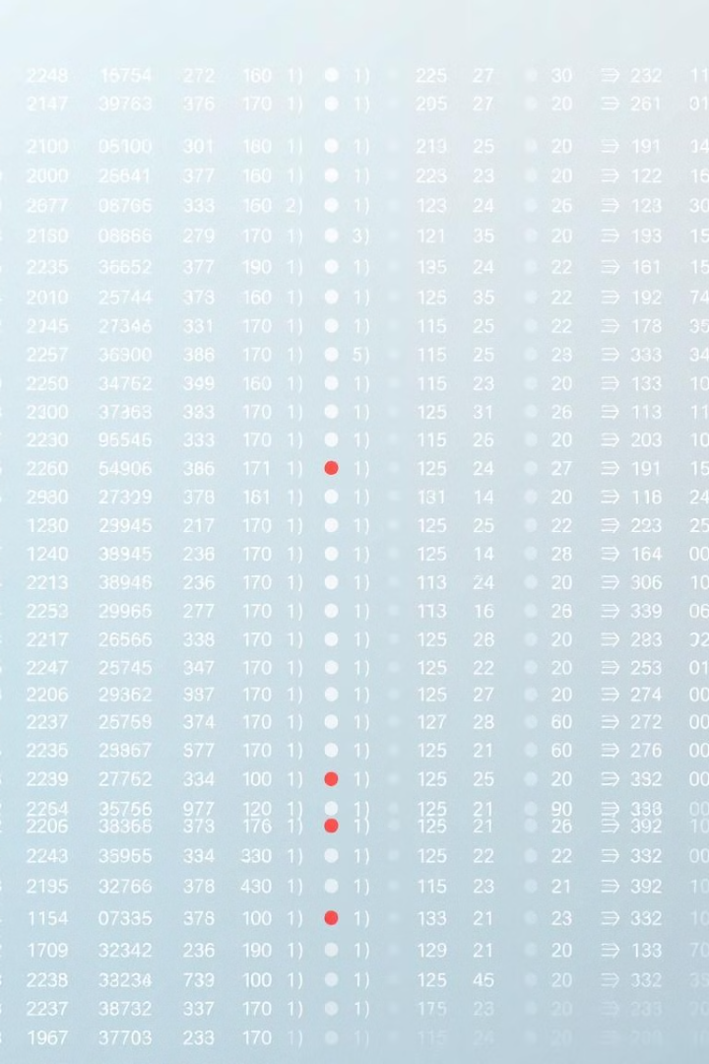


Handling Missing Values
Missing values pose a challenge. Several strategies are applied to deal with missing data. One approach is removing rows containing missing values. Alternatively, values are imputed using mean or median imputation.
Removal
Imputation
Remove rows with missing data.
Replace with mean or median.
Aryan Pandya

Slide 10
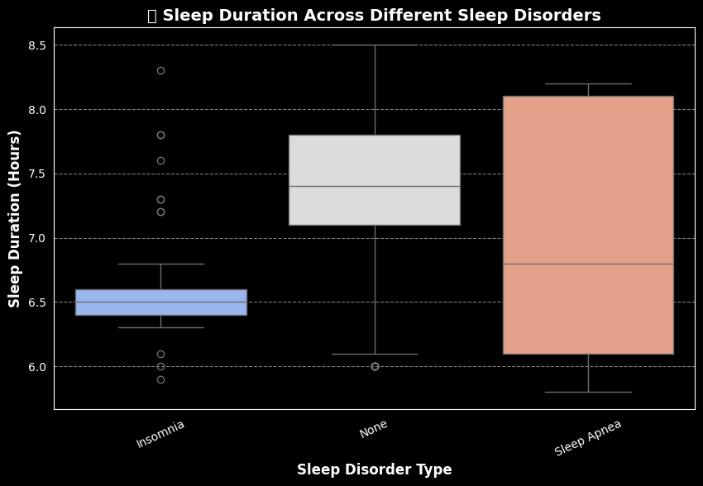
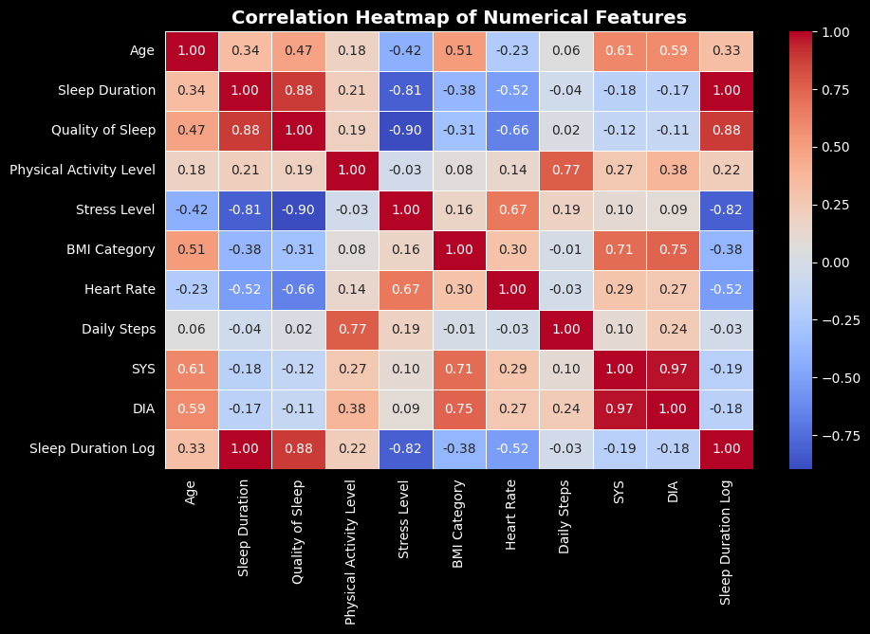
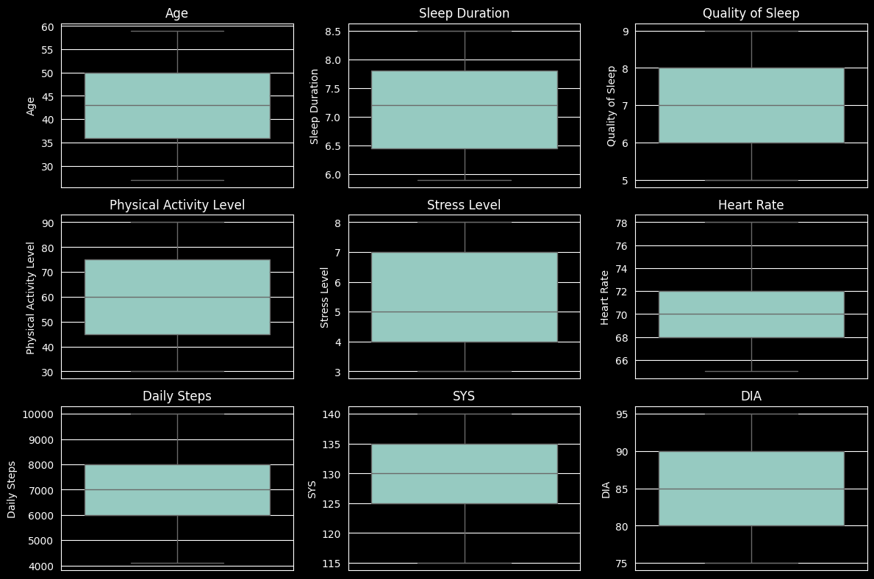
EDA:
Visual Analysis

Slide 11

Feature Engineering for Predictive Modeling
We will explore the feature engineering process. The process includes key features, model building, and evaluation. Join us as we dive deep into the world of data and predictive modeling.

Slide 12
Feature Engineering: Crafting Predictors from Raw Data
Variable Transformation
1
Feature engineering involves transforming raw data into meaningful predictors that can improve the performance of machine learning models. This includes techniques such as scaling, normalization, and encoding categorical variables. Variable transformation helps ensure that the data is in a suitable format for analysis.
2
Feature Selection
Feature selection aims to identify the most relevant variables for predicting sleep disorders. This can be achieved through various statistical and machine learning techniques, such as correlation analysis, recursive feature elimination, and feature importance ranking. Selecting the right features improves model accuracy and interpretability.
Interaction Terms
3
Interaction terms capture the combined effect of two or more variables on the outcome. By creating interaction terms, we can model complex relationships that may not be apparent when considering each variable in isolation. This can significantly improve the predictive power of the model.
Aryan Pandya

Slide 13
Understanding Key Features: BMI, Sleep, Lifestyle
BMI
Sleep Duration
Lifestyle Habits
Body Mass Index is a key health metric. It reflects weight relative to height. It helps assess healthy weight ranges.
Adequate sleep is vital for well-being. It impacts physical and mental health. Understanding sleep patterns is important.
Lifestyle habits influence health outcomes. These include diet, exercise, and habits. They're essential for predictive modeling.
Aryan Pandya

Slide 14

Creating New Features: BMI Categories & Risk Scores
1
BMI Categories
Categorizing BMI provides insights. Underweight, normal weight, overweight are groups. These improve model accuracy.
2
Lifestyle Risk Score
A risk score combines lifestyle factors. It summarizes habits into one metric. This simplifies model input.
Aryan Pandya

Slide 15


Encoding Categorical Features
Many features in the dataset are categorical. For example, occupation, sleep disorder type, etc. These features need to be converted into numeric format. One-hot encoding creates binary columns for each category. Label encoding assigns a unique number to each category.
1
One-Hot
Label Encoding
2
Aryan Pandya

Slide 16

Evaluation Metrics: Accuracy, Precision, Recall, F1-Score
Accuracy
Precision
Overall correctness of the model. Ratio of correct predictions to total predictions.
Ability to avoid false positives. Ratio of true positives to predicted positives.
Recall
F1-Score
Ability to capture all positives. Ratio of true positives to actual positives.
Harmonic mean of precision and recall. Balances precision and recall.
Aryan Pandya

Slide 17



Model Selection: Choosing the Right Algorithm for Prediction
Descision Tree
Random Forest
Support Vector Machines (SVM)
A Decision Tree is a simple yet powerful machine learning algorithm used for classification and regression tasks. It splits data into branches based on feature values, making decisions in a tree-like structure. Decision Trees are easy to interpret, handle both numerical and categorical data, and require minimal data preprocessing. However, they can be prone to overfitting without proper tuning.
Random Forest is an ensemble learning method that combines multiple decision trees to improve accuracy and robustness. It is effective in handling complex datasets with high dimensionality and can capture non-linear relationships. Random Forest is known for its ability to generalize well to unseen data.
Support Vector Machines (SVM) are powerful machine learning algorithms that can be used for both classification and regression tasks. SVMs aim to find the optimal hyperplane that separates the data into different classes. SVMs are particularly useful when dealing with high-dimensional data and non-linear relationships.
Accuracy : 90%
Accuracy : 91%
Accuracy : 93%
Aryan Pandya

Slide 18



Model Selection: Choosing the Right Algorithm for Prediction
Logistic Regression
K-Nearest Neighbors (KNN)
XGBoost
Logistic regression is a statistical model that predicts the probability of a binary outcome. It is widely used in classification problems and offers a balance between simplicity and predictive power. Logistic regression is particularly useful when the goal is to understand the factors that influence the probability of an event.
K-Nearest Neighbors (KNN) is a non-parametric, instance-based learning algorithm that classifies data points based on the majority class of their nearest neighbors. It is highly intuitive and effective for small datasets. KNN works well for classification and regression but can be computationally expensive for large datasets. Proper selection of the number of neighbors (K) is crucial for optimal performance.
XGBoost (Extreme Gradient Boosting) is a high-performance ensemble learning algorithm designed for both classification and regression. It builds multiple weak learners in sequence to minimize errors, making it highly accurate and efficient. XGBoost is known for its speed, scalability, and ability to handle missing data. It is widely used in data science competitions and real-world applications requiring predictive modeling.
Accuracy : 90%
Accuracy : 91%
Accuracy : 92%
Aryan Pandya

Slide 19
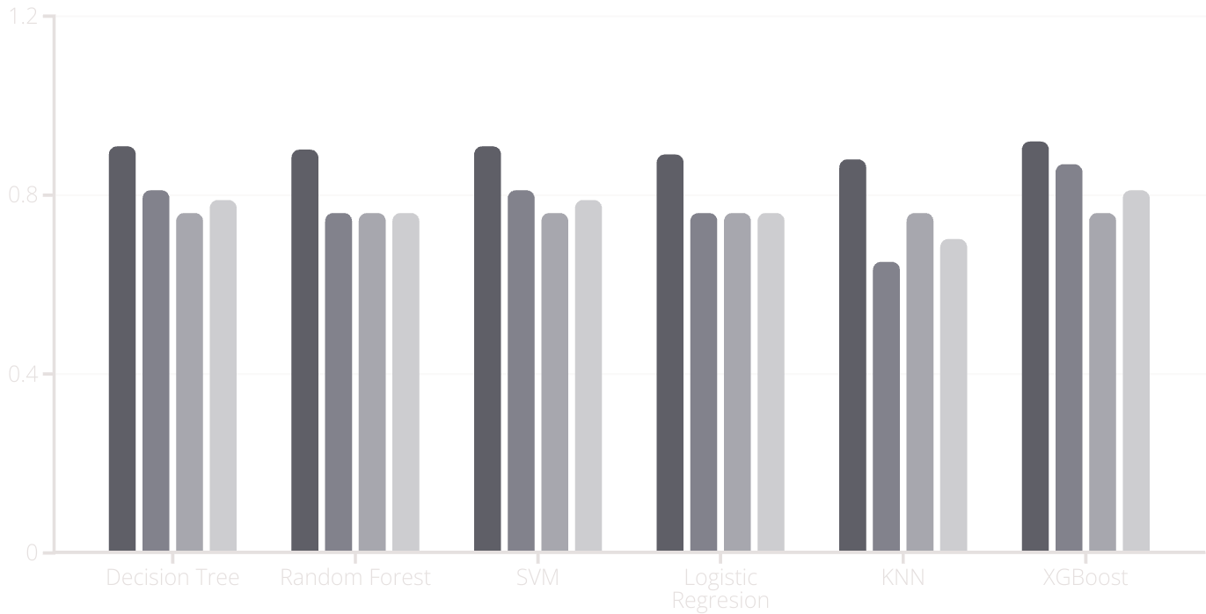
Model Performance Comparison: Benchmarking Results
Accuracy
Precision
Recall
F1-Score
Aryan Pandya

Slide 20
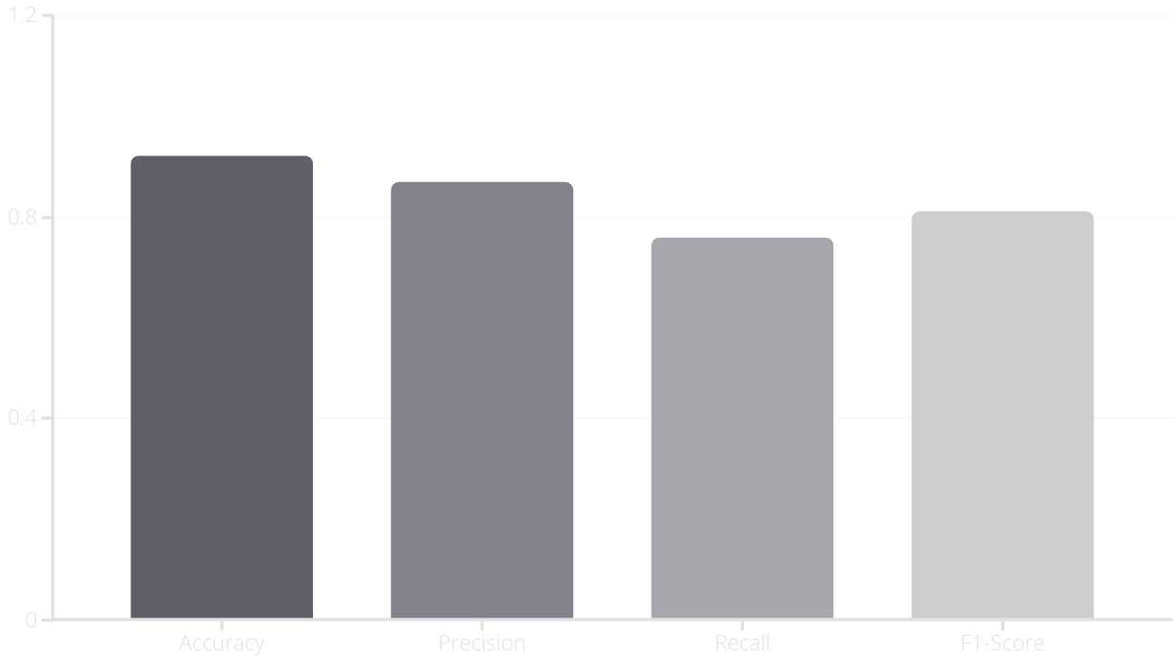
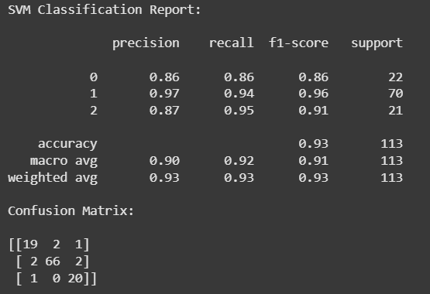
Results and Evaluation: Assessing Model Performance and Accuracy
Best Model here is SVM
The results of the model evaluation show promising performance in predicting sleep disorders. The model achieved an accuracy of 92%, indicating a high overall correctness in its predictions. Precision, which measures the accuracy of positive predictions, was 87%, while recall, which measures the ability to capture all positive instances, was 76%. The F1-score, which balances precision and recall, was 81%, suggesting a well-rounded performance.
Aryan Pandya

Slide 21



Conclusion: The Potential of AI in Sleep Disorder Diagnosis
Early Detection
AI enables early detection of sleep disorders by identifying subtle indicators that may be missed by traditional diagnostic methods. This allows for timely intervention and better patient outcomes.
Improved Accuracy
2
AI-driven models can enhance the accuracy of sleep disorder diagnosis by analyzing complex patterns and relationships within the data. This leads to more reliable and precise identification of individuals at risk.
1
Personalized Treatment
AI can facilitate personalized treatment plans by tailoring interventions to the individual's specific needs and characteristics. This results in more effective and targeted care.
3
Aryan Pandya

Slide 22
Thank You!
We truly appreciate your time and support. Your guidance and feedback have been invaluable in shaping this project.
Excited for future learning and collaboration! 🚀✨
Aryan Pandya

